Slide 1
Antecedentes individuais do comportamento organizacional
15
15 - 1

Slide 2
Objetivos
Identificar o que é o comportamento organizacional e os seus objetivos.
Explicar o papel das atitudes no desempenho do trabalho.
Descrever as diferentes teorias da personalidade.
Descrever o papel da perceção e os fatores que a influenciam.
Discutir teorias da aprendizagem e a sua relevância para o comportamento dos indivíduos.
Discutir assuntos atuais relacionados com o comportamento
organizacional.
15 - 2

Slide 3
Comportamento organizacional
Comportamento: As ações das pessoas.
Comportamento Organizacional
O estudo das ações das pessoas, no trabalho e nas organizações.
15 - 3
Notes:
Managers need good people skills. The material in this and the next three chapters draws heavily on the field of study that’s known as organizational behavior (OB). Although it’s concerned with the subject of behavior—that is, the actions of people— organizational behavior is the study of the actions of people at work.

Slide 4
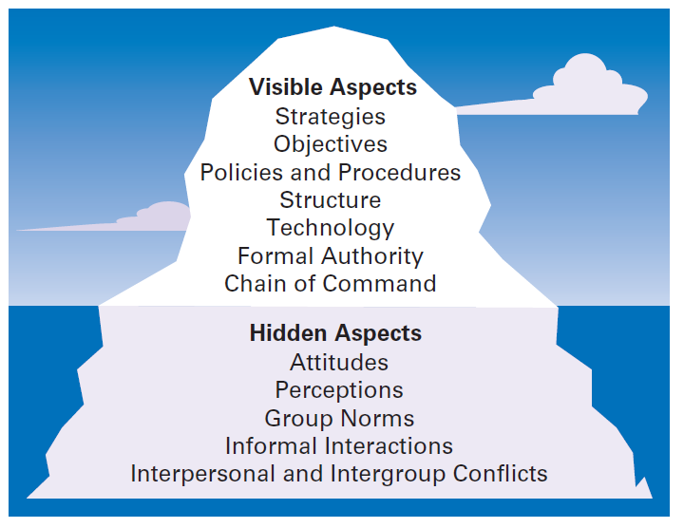
figura 15-1 as organizações como Icebergs
15 - 4
Notes:
One of the challenges in understanding organizational behavior is that it addresses issues that aren’t obvious. Like an iceberg, OB has a small visible dimension and a much larger hidden portion. (See Exhibit 15-1.)

Slide 5
Áreas do comportamento organizacional
O Comportamento Organizacional divide-se em três grandes áreas principais:
  O comportamento individual, incluindo: atitudes, personalidade, perceções, aprendizagem e motivação.
  O comportamento de grupo, incluindo: normas, papeis, construção de equipas, liderança e conflito.
  Outros aspetos organizacionais, incluindo: estrutura, cultura e políticas e práticas de GRH.
15 - 5
Notes:
Organizational behavior focuses on three major areas. First, OB looks at individual behavior. Based predominantly on contributions from psychologists, this area includes such topics as attitudes, personality, perception, learning, and motivation. Second, OB is concerned with group behavior, which includes norms, roles, team building, leadership, and conflict. Our knowledge about groups comes basically from the work of sociologists and social psychologists. Finally, OB also looks at organizational aspects including structure, culture, and human resource policies and practices. We’ve addressed group and organizational aspects in previous chapters. In this chapter, we’ll look at individual behavior.

Slide 6
Objetivos do estudo do comportamento organizacional
Os objetivos do estudo do Comportamento Organizacional são explicar, prever e influenciar os comportamentos de forma a:
  Aumentar a produtividade dos trabalhadores – uma medida que é influenciada pela eficiência e a eficácia.
  Reduzir o Absentismo – não comparecer para o trabalho.
  Reduzir oTurnover – Saída definitiva da organização (voluntária ou involuntária).
15 - 6
Notes:
The goals of OB are to explain, predict, and influence behavior. Managers need to be able to explain why employees engage in some behaviors rather than others, predict how employees will respond to various actions and decisions, and influence how employees behave.
What employee behaviors are we specifically concerned with explaining, predicting, and influencing? Six important ones have been identified: employee productivity, absenteeism, turnover, organizational citizenship behavior (OCB), job satisfaction, and workplace misbehavior. Employee productivity is a performance measure of both efficiency and effectiveness. Managers want to know what factors will influence the efficiency and effectiveness of employees. Absenteeism is the failure to show up for work. It’s difficult for work to get done if employees don’t show up. Turnover is the voluntary and involuntary permanent withdrawal from an organization. It can be a problem because of increased recruiting, selection, and training costs and work disruptions.

Slide 7
Objetivos do estudo do comportamento organizacional
Promover o comportamento de cidadania Organizacional
Comportamento que não faz parte dos requisitos formais de trabalho do empregado, mas que promove o funcionamento eficaz da organização.
Promover a satisfação no trabalho – relacionado com as atitudes genéricas dum empregado para com o seu trabalho.
15 - 7
Notes:
Organizational citizenship behavior (OCB) is discretionary behavior that’s not part of an employee’s formal job requirements but promotes the effective functioning of the organization.
Job satisfaction refers to an employee’s general attitude toward his or her job. Although job satisfaction is an attitude rather than a behavior, it’s an outcome that concerns many managers because satisfied employees are more likely to show up for work, have higher levels of performance, and stay with an organization.

Slide 8
Objetivos do estudo do comportamento organizacional
Minimizar os comportamentos desviantes no local de trabalho
Comportamentos intencionais que põem em causa o normal funcionamento da organização e dos seus trabalhadores.
15 - 8
Notes:
Workplace misbehavior is any intentional employee behavior that is potentially harmful to the organization or individuals within the organization. Workplace misbehavior shows up in organizations in four ways: deviance, aggression, antisocial behavior, and violence. Such behaviors can range from playing loud music just to irritate coworkers to verbal aggression to sabotaging work, all of which can create havoc in any organization.

Slide 9
Atitudes e desempenho no trabalho
Atitudes – considerações (avaliativas), favoráveis ou desfavoráveis, relacionadas com objetos, pessoas ou eventos.
As atitudes são constituídas por três componentes: cognitivo, afetivo e comportamental.
15 - 9
Notes:
Attitudes are evaluative statements—favorable or unfavorable—concerning objects, people, or events. They reflect how an individual feels about something. When a person says, “I like my job,” he or she is expressing an attitude about work. An attitude is made up of three components: cognition, affect, and behavior.

Slide 10
Atitudes e desempenho no trabalho
Componente Cognitiva – constituinte das atitudes relacionada com as crenças, opiniões, conhecimento ou informação detida por uma pessoa.
Componente Afetiva - constituinte das atitudes relacionada com a parte emocional ou sentimental.
Componente Comportamental - constituinte das atitudes relacionada com a intenção de se comportar de uma determinada forma em relação a algo ou alguém.
15 - 10
Notes:
The cognitive component of an attitude refers to the beliefs, opinions, knowledge, or information held by a person (for instance, the belief that “discrimination is wrong”). The affective component of an attitude is the emotional or feeling part of an attitude. Using our example, this component would be reflected by the statement, “I don’t like Pat because he discriminates against minorities.” Finally, affect can lead to behavioral outcomes. The behavioral component of an attitude refers to an intention to behave in a certain way toward someone or something.

Slide 11
Exemplo de atitudes
Satisfação no trabalho
Envolvimento no trabalho
Comprometimento organizacional
Perceção de apoio organizacional
Engagement
15 - 10
Notes:
The cognitive component of an attitude refers to the beliefs, opinions, knowledge, or information held by a person (for instance, the belief that “discrimination is wrong”). The affective component of an attitude is the emotional or feeling part of an attitude. Using our example, this component would be reflected by the statement, “I don’t like Pat because he discriminates against minorities.” Finally, affect can lead to behavioral outcomes. The behavioral component of an attitude refers to an intention to behave in a certain way toward someone or something.

Slide 12
Satisfação no trabalho
Elevada satisfação no trabalho resulta em atitudes positivas perante o mesmo.
Baixa satisfação no trabalho resulta em atitudes negativas perante o mesmo.
A (in)satisfação no trabalho está ligada à produtividade, absentismo, turnover, satisfação dos clientes, comportamentos de cidadania organizacional e bons(maus) comportamentos no local de trabalho.
15 - 11
Notes:
A person with a high level of job satisfaction has a positive attitude toward his or her job. A person who is dissatisfied has a negative attitude. When people speak of employee attitudes, they usually are referring to job satisfaction.

Slide 13
Envolvimento no trabalho e comprometimento organizacional
Envolvimento no trabalho – nível de participação e identificação do individuo com o seu trabalho e em que medida o desempenho no trabalho é importante para a sua autoimagem.
Comprometimento organizacional - nível de identificação do indivíduo com uma organização em particular e os seus objetivos e interesse em manter-se como um membro daquela organização.
15 - 12
Notes:
Job involvement is the degree to which an employee identifies with his or her job, actively participates in it, and considers his or her job performance to be important to his or her self-worth. Employees with a high level of job involvement strongly identify with and really care about the kind of work they do. Their positive attitude leads them to contribute in positive ways to their work.
Organizational commitment is the degree to which an employee identifies with a particular organization and its goals and wishes to maintain membership in that organization. Whereas job involvement is identifying with your job, organizational commitment is identifying with your employing organization.

Slide 14
Perceção de apoio organizacional
Perceção de apoio organizacional
Crença genérica, de um empregado, de que a sua organização valoriza as suas contribuições e o seu bem estar.
15 - 13
Notes:
Although the commitment of an employee to an organization may not be as important as it once was, research about perceived organizational support—employees’ general belief that their organization values their contribution and cares about their well-being—shows that the commitment of the organization to the employee can be beneficial. High levels of perceived organizational support lead to increased job satisfaction and lower turnover.

Slide 15
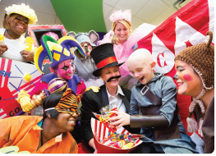
Engagement
Engagement
Quando os empregados sentem uma ligação, estão satisfeitos e entusiasmados com os seus empregos.
15 - 14
Notes:
Managers want their employees to be connected to, satisfied with, and enthusiastic about their jobs. This concept is known as employee engagement. Highly engaged employees are passionate about and deeply connected to their work. Disengaged employees have essentially “checked out” and don’t care. They show up for work, but have no energy or passion for it.

Slide 16
Teoria da dissonância Cognitiva
Dissonância Cognitiva
Qualquer incompatibilidade ou inconsistência entre Atitudes, ou entre Atitudes e Comportamento (algo que os indivíduos evitam pelo desconforto que causa).
Questionários sobre Atitudes – solicitam respostas dos indivíduos relativas a como eles se sentem em relação aos seus empregos, grupos de trabalho, supervisores, e/ou organização.
15 - 15
Notes:
Cognitive dissonance theory sought to explain the relationship between attitudes and behavior. Cognitive dissonance is any incompatibility or inconsistency between attitudes or between behavior and attitudes. The theory argued that inconsistency is uncomfortable and that individuals will try to reduce the discomfort and thus, the dissonance.
Many organizations regularly survey their employees about their attitudes. Typically, attitude surveys present the employee with a set of statements or questions eliciting how they feel about their jobs, work groups, supervisors, or the organization. Ideally, the items will be designed to obtain the specific information that managers desire. An attitude score is achieved by summing up responses to individual questionnaire items. These scores can then be averaged for work groups, departments, divisions, or the organization as a whole.

Slide 17
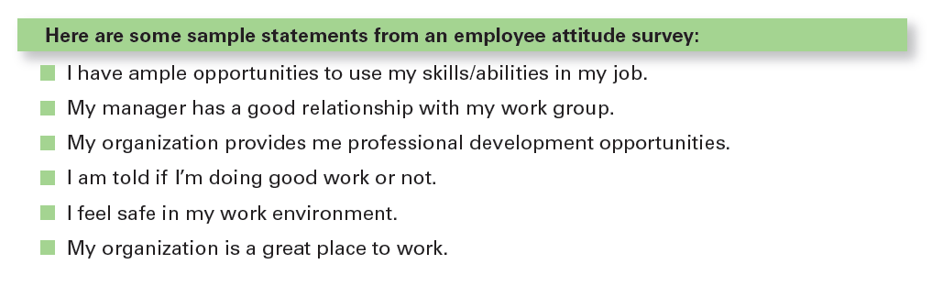
figura 15-2 exemplo de questionário sobre atitudes dos empregados
15 - 16
Notes:
Exhibit 15-2 shows an example of an actual attitude survey.

Slide 18
Personalidade
Personalidade
A combinação única de padrões emocionais, cognitivos e comportamentais que afetam a forma como um individuo reage às situações e interage com os outros.
15 - 17
Notes:
An individual’s personality is a unique combination of emotional, thought, and behavioral patterns that affect how a person reacts to situations and interacts with others. It’s our natural way of doing things and relating to others. Personality is most often described in terms of measurable traits a person exhibits. We’re interested in looking at personality because just like attitudes, it too, affects how and why people behave the way they do.

Slide 19
MBTI®
MBTI® (Myers-Briggs Type Indicator ) - um popular instrumento de avaliação da personalidade.
Com base na análise das respostas a 100 perguntas, classifica os indivíduos pelas suas preferências em cada uma das seguintes quatro categorias:
  Extroversão ou Introversão (E or I)
  Sensorial ou Intuição (S or N)
  Razão ou Sentimento (T or F)
  Julgamento ou Perceção (J or P).
15 - 18
Notes:
One popular approach to classifying personality traits is the personality-assessment instrument known as the MBTI®. This 100-question assessment asks people how they usually act or feel in different situations. On the basis of their answers, individuals are classified as exhibiting a preference in four categories: extraversion or introversion (E or I), sensing or intuition (S or N), thinking or feeling (T or F), and judging or perceiving (J or P).

Slide 20
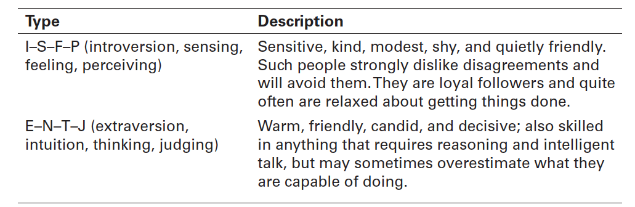
figura 15-3
Examplos de MBTI® tipos de Personalidade
15 - 19
Notes:
Combining these preferences provides descriptions of 16 personality types, with every person identified with one of the items in each of the four pairs. Exhibit 15-3 summarizes two of them. As you can see from these descriptions, each personality type would approach work and relationships differently—neither one better than the other, just different.

Slide 21
O modelo dos Big Five
O modelo dos Big Five – um modelo das características de personalidade que inclui:
  Openness to experience (abertura à experiência)
  Conscienciousness (conscienciosidade)
  Extroversion (extroversão)
  Agreableness (sociabilidade)
  Neuroticism (neuroticismo / estabilidade emocional)
15 - 20
Notes:
In recent years, research has shown that five basic personality dimensions underlie all others and encompass most of the significant variation in human personality. The five personality traits in the Big Five Model are:
1. Extraversion: The degree to which someone is sociable, talkative, assertive, and comfortable in relationships with others.
2. Agreeableness: The degree to which someone is good-natured, cooperative, and trusting.
3. Conscientiousness: The degree to which someone is reliable, responsible, dependable, persistent, and achievement oriented.
4. Emotional stability: The degree to which someone is calm, enthusiastic, and secure (positive) or tense, nervous, depressed, and insecure (negative).
5. Openness to experience: The degree to which someone has a wide range of interests and is imaginative, fascinated with novelty, artistically sensitive, and intellectual.

Slide 22
Notas adicionais sobre personalidade
Locus de controle – Perspectiva que um indivíduo tem, sobre o tipo de fatores que determinam o seu destino - fatores internos ou externos.
Maquiavelismo – até que ponto as pessoas são pragmáticas, mantêm alguma distância emocional e acreditam que os meios justificam os fins.
15 - 21
Notes:
Some people believe they control their own fate. Others see themselves as pawns, believing that what happens to them in their lives is due to luck or chance. The locus of control in the first case is internal; these people believe they control their own destiny. The locus of control in the second case is external; these people believe their lives are controlled by outside forces.
Another characteristic is called Machiavellianism (Mach), named after Niccolo Machiavelli, who wrote in the sixteenth century on how to gain and manipulate power. An individual high in Machiavellianism is pragmatic, maintains emotional distance, and believes that ends can justify means.

Slide 23
Notas adicionais sobre personalidade (cont.)
Autoestima
O quanto um indivíduo gosta, ou não, de si próprio.
Autocontrole
Capacidade de ajustar o comportamento a novas situações, decorrentes de condicionantes externas.
15 - 22
Notes:
People differ in the degree to which they like or dislike themselves, a trait called self-esteem. Research on self-esteem (SE) offers some interesting behavioral insights. For example, self-esteem is directly related to expectations for success. High SEs believe they possess the ability they need to succeed at work. Individuals with high SEs will take more risks in job selection and are more likely to choose unconventional jobs than people with low SEs.
That natural ability to “click” with other people may play a significant role in determining career success and is another personality trait called self-monitoring, which refers to the ability to adjust behavior to external, situational factors. Individuals high in self-monitoring show considerable adaptability in adjusting their behavior. They’re highly sensitive to external cues and can behave differently in different situations.

Slide 24
Notas adicionais sobre personalidade (cont.)
Proatividade – característica das pessoas que identificam oportunidades, demonstram iniciativa, tomam ações e são perseverantes no sentido de obterem mudanças significativas.
Resiliência – a capacidade dum indivíduo para ultrapassar desafios, resistindo e ultrapassando sucessivas barreiras/dificuldades, tornando-os em oportunidades.
15 - 23
Notes:
Another interesting trait that’s been studied extensively is the proactive personality, which describes people who identify opportunities, show initiative, take action, and persevere until meaningful change occurs. Not surprisingly, research has shown that proactives have many desirable behaviors that organizations want.
Finally, the economic recession has prompted a reexamination of resilience, an individual’s ability to overcome challenges and turn them into opportunities. A recent study by a global consulting firm showed that it is a key factor in keeping a job: A resilient person is likely to be more adaptable, flexible, and goal-focused.

Slide 25
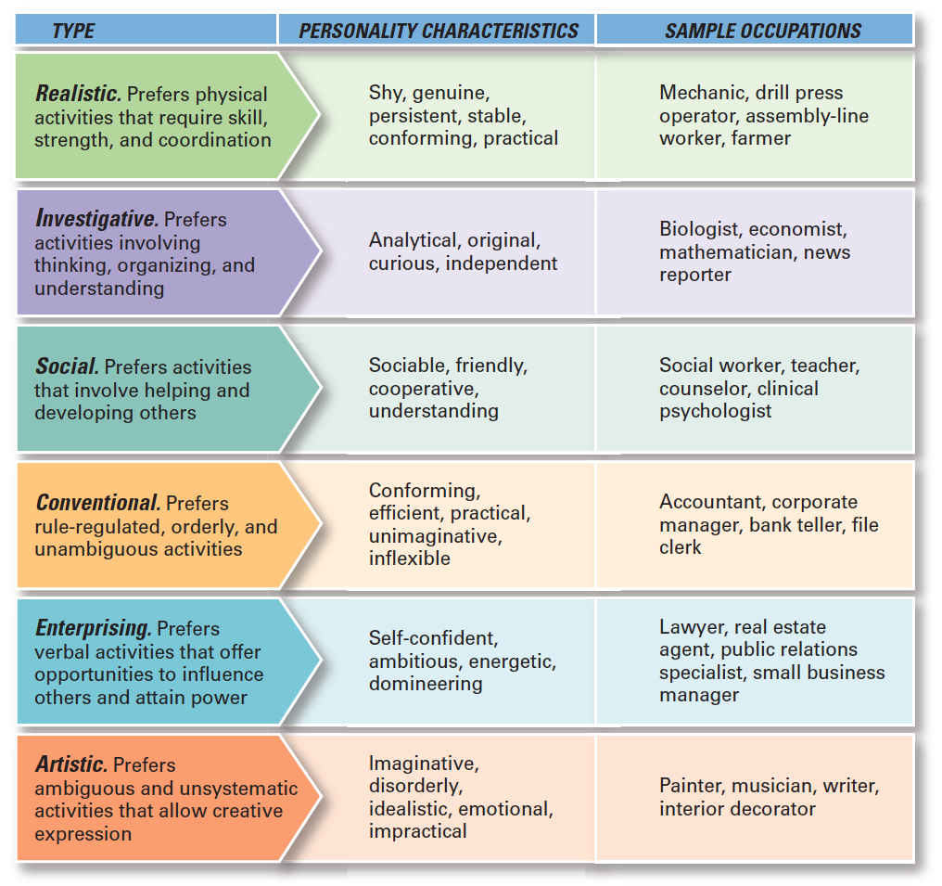
figura 15-4 personalidade e tipos de emprego (Holland)
15 - 27
Notes:
The best-documented personality-job fit theory was developed by psychologist John Holland, who identified six basic personality types. His theory states that an employee’s satisfaction with his or her job, as well as his or her likelihood of leaving that job, depends on the degree to which the individual’s personality matches the job environment. Exhibit 15-4 describes the six types, their personality characteristics, and examples of suitable occupations for each.

Slide 26
Emoções e inteligência emocional
Emoções
Sentimentos intensos relativos a algo ou alguém.
Inteligência Emocional (IE)
A capacidade de observar e gerir as evidências e as informações relativas às emoções.
15 - 24
Notes:
How we respond emotionally and how we deal with our emotions are typically functions of our personality. Emotions are intense feelings directed at someone or something. They’re object-specific; that is, emotions are reactions to an object.
One area of emotions research with interesting insights into personality is emotional intelligence (EI), the ability to notice and to manage emotional cues and information.

Slide 27
Cinco dimensões da inteligência emocional (IE) de goleman
A Inteligência Emocional (IE) é composta por cinco dimensões:
  Autoconsciência: Ser capaz de identificar o que se está a sentir e porquê.
  Autocontrolo: Ser capaz de gerir os próprios sentimentos e os impulsos para reagir automaticamente.
15 - 25
Notes:
Emotional Intelligence is composed of five dimensions:
Self-awareness: The ability to be aware of what you’re feeling.
Self-management: The ability to manage one’s own emotions and impulses.
Self-motivation: The ability to persist in the face of setbacks and failures.

Slide 28
Cinco dimensões da inteligência emocional (IE) de Goleman (cont.)
  Automotivação: A capacidade de criar motivação para o comportamento pretendido, mesmo quando confrontado com adversidades.
  Empatia: A sensibilidade para perceber e entender o que sentem os outros.
  Competências Sociais: Capacidade de gerir as emoções dos outros.
15 - 26
Notes:
The last two dimensions of EI are:
Empathy: The ability to sense how others are feeling.
Social skills: The ability to handle the emotions of others.

Slide 29
Perceção
Perceção
Um processo através do qual nós atribuímos sentido ao nosso meio-envolvente e interpretamos os estímulos sensoriais.
Fatores que condicionam as perceções:
  Indivíduo que perceciona;
  Alvo da atenção;
  Situação.
15 - 28
Notes:
Perception is a process by which we give meaning to our environment by organizing and interpreting sensory impressions.
Research on perception consistently demonstrates that individuals may look at the same thing yet perceive it differently. One manager, for instance, can interpret the fact that her assistant regularly takes several days to make important decisions as evidence that the assistant is slow, disorganized, and afraid to make decisions. Another manager with the same assistant might interpret the same tendency as evidence that the assistant is thoughtful, thorough, and deliberate. The first manager would probably evaluate her assistant negatively; the second manager would probably evaluate the person positively. The point is that none of us sees reality. We interpret what we see and call it reality. And, of course, as the example shows, we behave according to our perceptions.

Slide 30
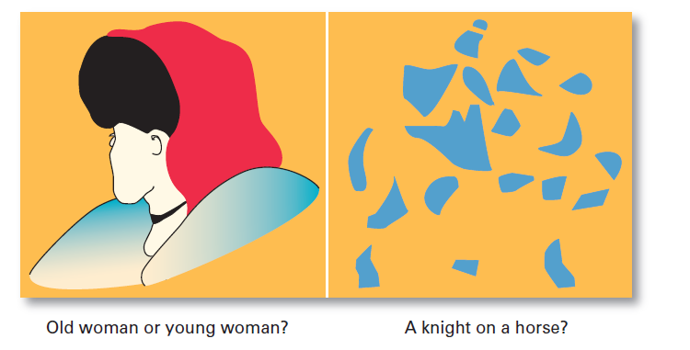
figura 15-5 o que vê aqui?
15 - 29
Notes:
The characteristics of the target being observed can also affect what’s perceived. Loud people are more likely than quiet people to be noticed in a group as are extremely attractive or unattractive individuals. The relationship of a target to its background also influences perception, as does our tendency to group close things and similar things together. You can experience these tendencies by looking at the visual perception examples shown in Exhibit 15-5. Notice how what you see changes as you look differently at each one.

Slide 31

M. C. ESCHER (1898-1972)

Slide 32
Perceções versus reALIDADE
Número de passes – basketball (2’)
http://www.youtube.com/watch?v=vJG698U2Mvo
Conversa informal (2’)
http://www.youtube.com/watch?v=6JONMYxaZ_s
Ted Talk (7’00 - 13’00)
http://www.youtube.com/watch?v=LsBWLHc2ezY
Cinzento (2’)
http://www.youtube.com/watch?v=BnPbT3wgfG8

Slide 33
TEORIA DA ATRIBUIÇÃO
Teoria da Atribuição
A forma como são percecionadas as ações de determinados indivíduos por outros, depende do sentido (causalidade) que este atribuem a esse comportamento.
  A atribuição depende de três fatores:
  Especificidade;
  Consenso;
  Consistência.
15 - 30
Notes:
Attribution theory was developed to explain how we judge people differently depending on what meaning we attribute to a given behavior. Basically, the theory suggests that when we observe an individual’s behavior, we attempt to determine whether it was internally or externally caused. Internally caused behaviors are those believed to be under the personal control of the individual. Externally caused behavior results from outside factors; that is, the person is forced into the behavior by the situation. That determination, however, depends on three factors: distinctiveness, consensus, and consistency.

Slide 34
TEORIA DA ATRIBUIÇÃO (CONT.)
Erro fundamental de Atribuição – No caso de terceiros, imputam-se responsabilidades pessoais imediatas pelos insucessos e desconta-se o crédito pessoal pelos sucessos com fatores externos.
Enviesamento da autoconveniência - Admitir rapidamente o crédito pessoal pelos sucessos e descontar a responsabilidade pelos insucessos em fatores externos.
15 - 31
Notes:
One interesting finding from attribution theory is that errors or biases distort our attributions. For instance, substantial evidence supports the fact that when we make judgments about the behavior of other people, we have a tendency to underestimate the influence of external factors and to overestimate the influence of internal or personal factors. This tendency is called the fundamental attribution error and can explain why a sales manager may attribute the poor performance of her sales representative to laziness rather than to the innovative product line introduced by a competitor.
This tendency is called the self-serving bias and suggests that feedback provided to employees in performance reviews will be distorted by them depending on whether it’s positive or negative.

Slide 35
TEORIA DA ATRIBUIÇÃO
Resultados Resultados
Positivos Negativos
Eu ou o meu grupo
Outros indivíduos
ou outros grupos
Atribuições Atribuições
Internas Externas
Atribuições Atribuições
Externas Internas
15 - 32
Notes:
Exhibit 15-6 summarizes the key elements of attribution theory.

Slide 36
SIMPLIFICAÇÕES UTILIZADAS PARA JULGAR OUTROS
Assunção de semelhança – os outros são, pensam e/ou reagem como nós.
Estereótipo – julgar as pessoas com base nas perceções que temos dos grupos a que estas pertencem.
Efeito de Halo – uma impressão geral sobre um indivíduo baseada numa única característica sua (i.e. do indivíduo).
15 - 33
Notes:
It’s easy to judge others if we assume they’re similar to us. In assumed similarity, or the “like me” effect, the observer’s perception of others is influenced more by the observer’s own characteristics than by those of the person observed.
When we judge someone on the basis of our perception of a group he or she is part of, we’re using the shortcut called stereotyping. For instance, “Married people are more stable employees than single persons” is an example of stereotyping.
When we form a general impression about a person on the basis of a single characteristic, such as intelligence, sociability, or appearance, we’re influenced by the halo effect.

Slide 37
APRENDIZAGEM
Aprendizagem
Qualquer mudança (relativamente) permanente no comportamento, que decorre de experiência.
Duas teorias de aprendizagem:
  Condicionamento instrumental (ou operante);
  Aprendizagem Social.
15 - 34
Notes:
Learning occurs all the time as we continuously learn from our experiences. A workable definition of learning is any relatively permanent change in behavior that occurs as a result of experience. Two learning theories help us understand how and why individual behavior occurs.

Slide 38
CondiCIONAMENTO INSTRUMENTAL
Condicionamento instrumental – o comportamento deriva das suas consequências.
  Os comportamentos são aprendidos ao estarem associados a determinados efeitos (recompensas ou punições).
  O comportamento que é recompensado é provável que se repita.
  O comportamento que é punido ou ignorado é menos provável se repita.
15 - 35
Notes:
Operant conditioning argues that behavior is a function of its consequences. People learn to behave to get something they want or to avoid something they don’t want. Operant behavior is voluntary or learned behavior, not reflexive or unlearned behavior. The tendency to repeat learned behavior is influenced by reinforcement or lack of reinforcement that happens as a result of the behavior. Reinforcement strengthens a behavior and increases the likelihood that it will be repeated. Lack of reinforcement weakens a behavior and lessens the likelihood that it will be repeated.

Slide 39
APRENDIZAGEM SOCIAL
Teoria da Aprendizagem Social – os indivíduos aprendem por experiência direta ou por observação.
A aprendizagem depende dos seguintes processos:
    Atenção;
    Retenção (Memória);
    Reprodução motora;
    Recompensa.
15 - 36
Notes:
Much of what we have learned comes from watching others (models)—parents, teachers, peers, television and movie actors, managers, and so forth. This view that we can learn both through observation and direct experience is called social learning theory. The influence of others is central to the social learning viewpoint. The amount of influence these models have on an individual is determined by four processes:
Attentional processes. People learn from a model when they recognize and pay attention to its critical features. We’re most influenced by models who are attractive, repeatedly available, thought to be important, or seen as similar to us.
Retention processes. A model’s influence will depend on how well the individual remembers the model’s action, even after the model is no longer readily available.
Motor reproduction processes. After a person has seen a new behavior by observing the model, the watching must become doing. This process then demonstrates that the individual can actually do the modeled activities.
4. Reinforcement processes. Individuals will be motivated to exhibit the modeled behavior if positive incentives or rewards are provided. Behaviors that are reinforced will be given more attention, learned better, and performed more often.

Slide 40
MUDAR COMPORTAMENTOS: UMA FERRAMENTA DA GESTÃO
Mudar comportamentos – através de um processo de aprendizagem direcionada com base na recompensa e a ausência de recompensa.
    Recompensa: comportamentos desejados são promovidos
    Punição: penalizar comportamentos indesejados
    Extinção da recompensa (ou dum efeito positivo): eliminar uma recompensa relativa a um comportamento indesejado
    Remoção da punição (ou dum efeito negativo): quando os comportamentos indesejados são terminados
15 - 37
Notes:
Because learning takes place on the job as well as prior to it, managers are concerned with how they can teach employees to behave in ways that most benefit the organization. Thus, managers will often attempt to “mold” individuals by guiding their learning in graduated steps, through a method called shaping behavior.
Four ways to shape behavior include positive reinforcement, negative reinforcement, punishment, and extinction. When a behavior is followed by something pleasant, such as praising an employee for a job well done, it’s called positive reinforcement. Positive reinforcement increases the likelihood that the desired behavior will be repeated. Rewarding a response by eliminating or withdrawing something unpleasant is negative reinforcement. A manager who says, “I won’t dock your pay if you start getting to work on time” is using negative reinforcement. The desired behavior (getting to work on time) is being encouraged by the withdrawal of something unpleasant (the employee’s pay being docked). On the other hand, punishment penalizes undesirable behavior and will eliminate it. Suspending an employee for two days without pay for habitually coming to work late is an example of punishment. Finally, eliminating any reinforcement that’s maintaining a behavior is called extinction. When a behavior isn’t reinforced, it gradually disappears.

Slide 41
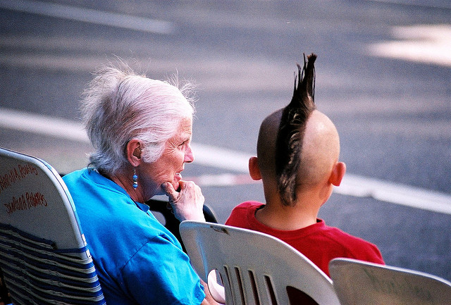
ASSUNTOS ATUAIS NO COMPORTAMENTO ORGANIZACIONAL
Gerir trabalhadores de diferentes gerações no local de trabalho.
15 - 38
Notes:
There’s no consensus about the exact time span that Gen Y comprises, but most definitions include those individuals born from about 1982 to 1997. One thing is for sure—they’re bringing new attitudes with them to the workplace. Gen Ys have grown up with an amazing array of experiences and opportunities. And they want their work life to provide that as well. Managing Gen Y workers presents some unique challenges. Conflicts and resentment can arise over issues such as appearance, technology, and management style.

Slide 42
ASSUNTOS ATUAIS NO COMPORTAMENTO ORGANIZACIONAL
Gerir comportamentos negativos / desviantes no local de trabalho.
  Selecionar candidatos com personalidades adequadas para as funções e para a organização.
  Responder de forma imediata e decisiva a comportamentos considerados inaceitáveis.
15 - 39
Notes:
Most managers dread having to deal with difficult employees. However, they can’t just ignore the problems. So, what can managers do to manage negative behavior in the workplace?
The main thing is to recognize that it’s there. Pretending that negative behavior doesn’t exist or ignoring such misbehaviors will only confuse employees about what is expected and acceptable behavior. Although some debate among researchers questions whether preventive or responsive actions to negative behaviors are more effective, in reality, both are needed. Preventing negative behaviors by carefully screening potential employees for certain personality traits and responding immediately and decisively to unacceptable negative behaviors can go a long way toward managing negative workplace behaviors. But it’s also important to pay attention to employee attitudes, because negativity will show up there as well. As we said earlier, when employees are dissatisfied with their jobs, they will respond somehow.

Slide 43


